Slide 1
Chapter Objectives
After studying this chapter, the reader should be able to:
Outline the Indian constitutional provisions regarding the environment
Describe the beginnings of environmental legislation in India
Recall the main provisions of
  Environment (Protection) Act of 1986
  Air (Prevention and Control of Pollution) Act of 1981
  Water (Prevention and Control of Pollution) Act 1974
  Forest Conservation Act of 1980
  Wildlife Protection Act of 1972

Slide 2
Chapter Objectives (contd.)
Explain the requirement of an Environmental Impact Assessment for certain types of projects
Appreciate the role played by public interest litigation and judicial activism in enforcing environmental laws in India
Describe the role of the National Green Tribunal
Explain environmental ethics and the three different ways of viewing environmental responsibility
Recall the meaning of environmental justice

Slide 3
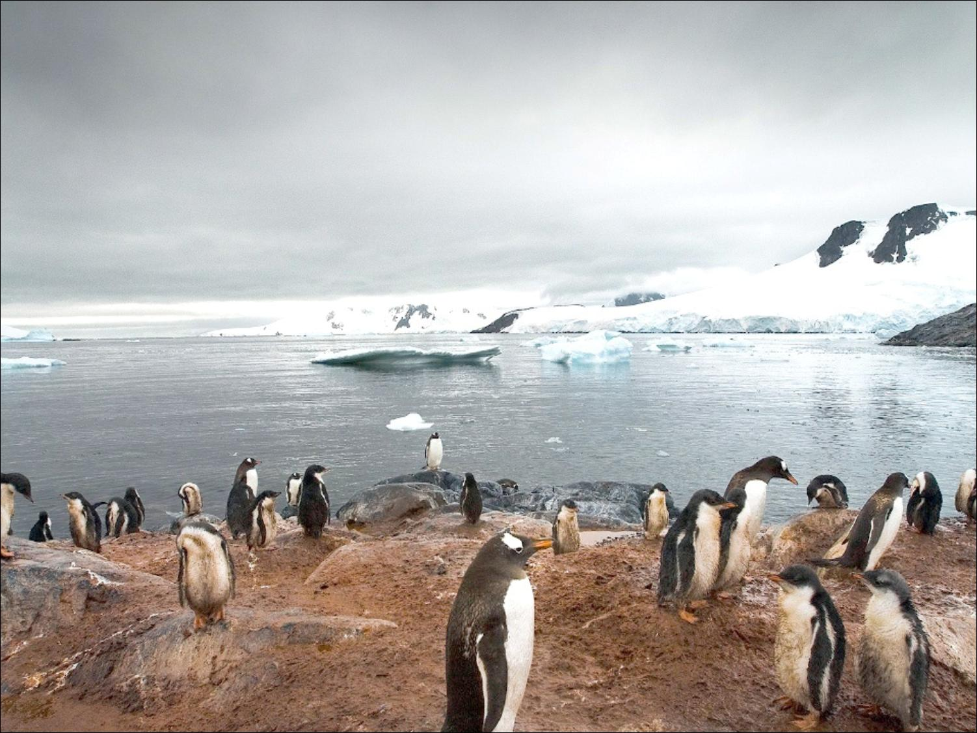
Environmental Laws and Regulations
CHAPTER 6
Environmental Studies

Slide 4
The Story of the Ganga
The Ganga Pollution case (1985) in the Supreme Court was against the pollution of the river by:
    Hundreds of polluting industries in Uttar Pradesh, Bihar, and West Bengal
    A number of municipalities and corporations discharging untreated sewage into the river
    The Eastern Railway
Court took quick decisions to make the parties follow effluent standards and stop the pollution
Case was handled by lawyer M.C.Mehta
Court action did not completely solve the problem
Later attempts by the government to clean up Ganga have not succeeded.

Slide 5
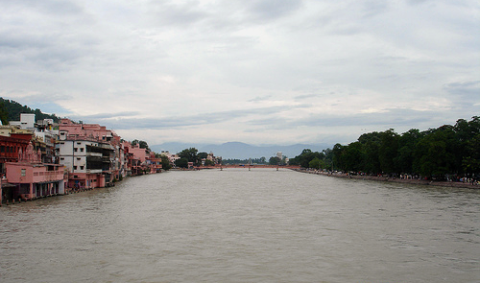
The Story of the Ganga

Slide 6
Environmental Laws in India
Many laws passed after Bhopal Gas Tragedy, such as:
Air (Prevention and Control of Pollution) Act of 1981
Water (Prevention and Control of Pollution) Act 1974
Forest Conservation Act of 1980
Wildlife Protection Act of 1972

Slide 7
Air (Prevention and Control of Pollution) Act of 1981
Objective:
Is to control and prevent air pollution.
Define air pollution.
Concentration of air pollutant.
Setting air quality standard.
Collecting data on air pollution.
Establishing laboratories.
Specify air pollution control area
Set standard for vehicle emmision.
Organizing training and awareness programmes.
The act is implemented by Central Pollution control board along with state board.
This act lays down penalties for violation of its provision.
Applies to companies, their owners, managers as well as government departments. Any citizen can file complaints with the board.

Slide 8
Water related laws in India
Easement Act of 1882:
Allow private right to ground water if it is an attachment to the land.
All surface water belongs to state and is a state property
Indian Fisheries Act of 1897:
Government can take legal action if any person uses dynamite or other explosive in any way to catch or destroy any fish or poison fish in order to kill.
Merchant Shipping Act of 1970:
Deals with waste arising form ships along the coastal areas.

Slide 9
Water (Prevention and Control of Pollution) Act of 1974
Objective:
Is to control and prevent water pollution, and the maintenance or restoration of the integrity of water.
Define water pollution.
Setting water quality standard.
Collecting data on water pollution.
Establishing laboratories.
Polluting industries must seek permission to discharge waste into effluents bodies.
The act is implemented by Central Pollution control board along with state board.

Slide 10
Forest Conservation Act of 1980
Objective:
This Act along with Forest Conservation Rule of 1981 is provide for protection and conservation of forest.
Declare an area as a protected Forest, Wildlife sanctuary or a National park.
Under this Act any government may regulate or prohibit deforestation for cultivation, range land etc. because for
  Protection against Wind, Storm etc.
  Preservation of soil on slope,
  For prevention of landslip etc.
  Maintenance of water supply in sprigs, rivers etc.
  Protection of road, bridges, railways etc.
  Preservation of public health.
Forest owner must seek permission before converting it to any non-forest purposes.

Slide 11
Wildlife Conservation Act of 1972
Define wildlife to includes animals, bees, butterflies, fish, moth , aquatic and land vegetation which form a part of habitat.
This Act along with Wildlife Protection Rule of 1973 provide for protection of birds, animals and all the matters (forest that provides habitat and food) that connected to it

Slide 12
Important Environment related Acts and Rules
Hazardous Waste (Management and Handling) Rule of 1989: Control the generation, collection, treatment, import, storage and handling of hazardous waste.
Manufacturing, Storage and Import of Hazarduos Chemical Rule of 1889: Inspect once a year the industrial activities connected with hazardous chemicals, storage facilities.
Public Liability Insurance Act and Rule of 1991 and Amendment 1992: For providing Public liability insurance for the purpose providing immediate relief person affected by accident while handling any hazardous substance.

Slide 13
Important Environment related Acts and Rules
National Environmental Tribunal Act of 1995: Award compensation for damage to persons, property and the environment arising from any activity involving hazardous substances.
Biomedical Waste (Management and Handling) Rule of 1998: Apply to healthcare institutions to streamline the process of proper handling of hospital waste.
Coastal Regulation Zone Notification of 1991: Regulate construction, in the coastal zone. Give some protection to back water and Estuaries.

Slide 14
Issues Involved in Enforcement of Environmental Laws
There is no dearth of laws for protection and conservation of environment.
Poor implementation.
Reluctance of government to use these power to discipline the polluters (Industries and other potential polluters)
The Parliament and state agencies are ready to pass environmental laws but do not provide funds for their implementation.
Due to poor performance of government agencies, Courts plays a role in the matter of environment.
Courts forcing the state government to act against pollution and degradation of environment. :
Shift factories, Change to less polluting technology,
As a result of Judicial activism , Hundreds of factories installed effluent treatment plants

Slide 15

The story of M.C.Mehta: The Green Avenger

Slide 16
Keywords & Phrases of Chap.
environmental ethics
Environmental Impact Assessment
judicial activism
public interest litigation
National Green Tribunal

Slide 17
Key Points of Chap.
  India has many laws to protect the environment, but the implementation has been poor.
  Responding to public interest litigation by citizens and groups, the courts have been taking a pro-active role to enforce environmental laws in India.
  We have constitutional provisions to safeguard the environment
  The Bhopal Tragedy gave the impetus for passing several environmental laws incorporating regulatory mechanisms.

Slide 18
Key Points of Chap. (contd.)
The Environment (Protection) Act of 1986 is an enabling law, providing powers to the executive to frame various rules and regulations.
An Environmental Impact Assessment (EIA) is mandatory for certain types of projects.
We have specific laws concerning air, water, forests, wild life, hazardous waste, etc., but the enforcement of all these laws is poor.
Environmental ethics try to define the moral basis of environmental responsibility.

